Slide 1
Distributed Databases

Slide 2
Motivation
Database
Technology
Computer
Networks
integration
distribution
Distributed
Database
Systems
integration
integration ≠ centralization

Slide 3
Distributed Computing
A number of autonomous processing elements (not necessarily homogeneous) that are interconnected by a computer network and that cooperate in performing their assigned tasks.
What is being distributed?
Processing logic
Function
Data
Control

Slide 4
What is a Distributed Database System?
A distributed database (DDB) is a collection of multiple, logically interrelated databases distributed over a computer network.
A distributed database management system (D–DBMS) is the software that manages the DDB and provides an access mechanism that makes this distribution transparent to the users.
Distributed database system (DDBS) = DDB + D–DBMS

Slide 5
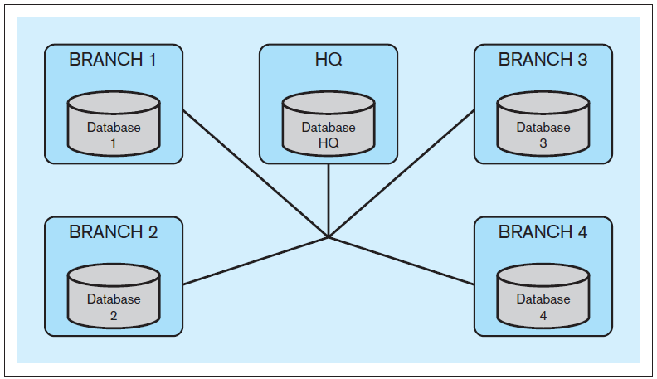
Distributed Databases, cont’d
Example: Bank headquarters and branches.
Each branch maintains data about its customers.
Each branch can access data from other branches.
Each branch can access administrative HQ data.
HQ can access branch data.

Slide 6
What is not a DDBS?
A timesharing computer system
A loosely or tightly coupled multiprocessor system
A database system which resides at one of the nodes of a network of computers - this is a centralized database on a network node

Slide 7
Centralized DBMS on a Network
Site 1
Site 2
Site 5
Communication
Network
Site 4
Site 3

Slide 8
Distributed DBMS Environment
Site 1
Site 2
Site 5
Communication
Network
Site 4
Site 3

Slide 9
Distribution Transparency
End users of the DDBS should not be concerned about the distributed nature of the system.
End users of the DDBS should not know if the data they are accessing is stored locally or remotely at a different geographic location.
End users can use the DDBS in the same way as if the data were not distributed.

Slide 10
Data Delivery Alternatives
Delivery modes
Pull-only
Push-only
Hybrid
Frequency
Periodic
Conditional
Ad-hoc or irregular
Communication Methods
Unicast
One-to-many
Note: not all combinations make sense

Slide 11
Distributed DBMS Promises
Transparent management of distributed, fragmented, and replicated data
Improved reliability/availability through distributed transactions
Improved performance
Easier and more economical system expansion

Slide 12
Types of Transparency
Data independence
Network transparency (or distribution transparency)
Location transparency
Fragmentation transparency
Replication transparency
Fragmentation transparency

Slide 13
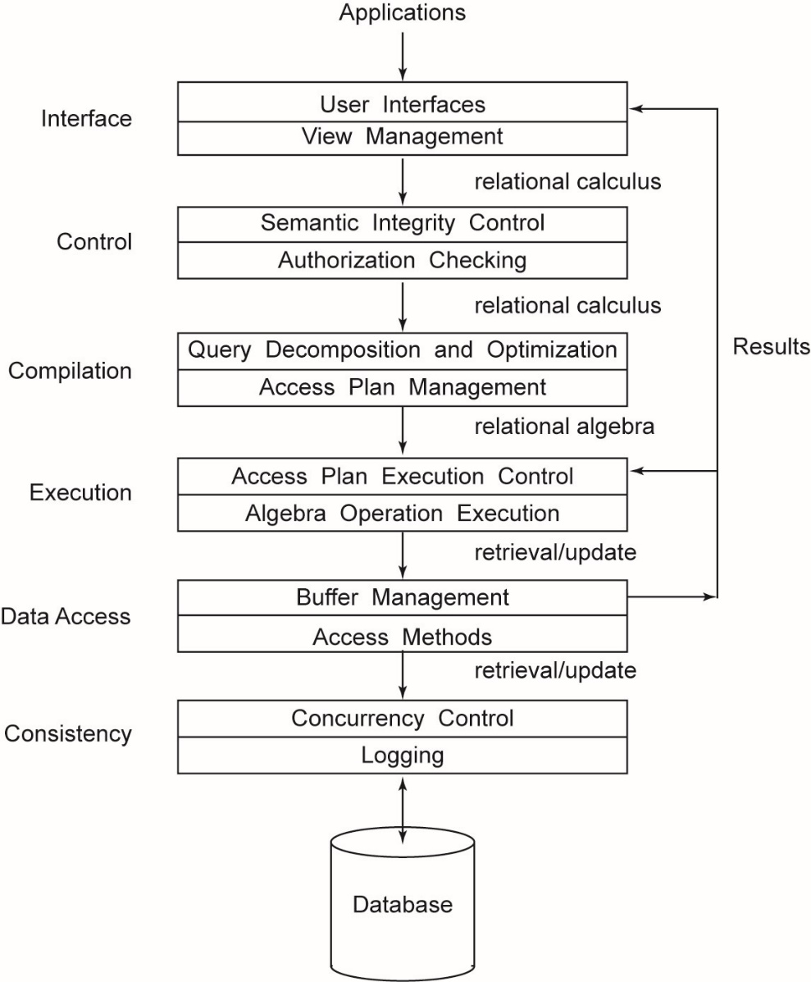
Generic DBMS Architecture

Slide 14
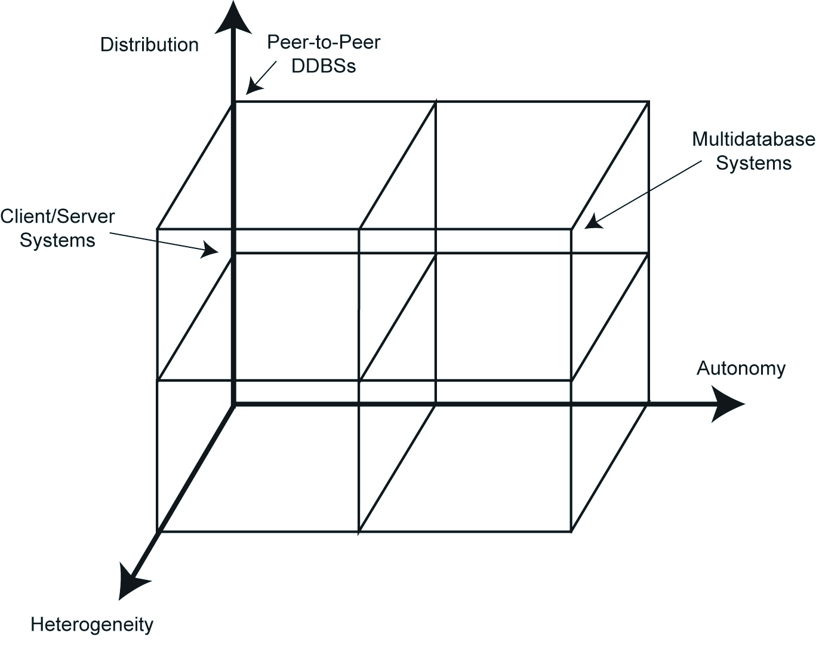
DBMS Implementation Alternatives

Slide 15
Dimensions of the Problem
Distribution
Whether the components of the system are located on the same machine or not
Heterogeneity
Various levels (hardware, communications, operating system)
DBMS important one
data model, query language,transaction management algorithms
Autonomy
Most troublesome
Various versions
Design autonomy: Ability of a component DBMS to decide on issues related to its own design.
Communication autonomy: Ability of a component DBMS to decide whether and how to communicate with other DBMSs.
Execution autonomy: Ability of a component DBMS to execute local operations in any manner it wants to.

Slide 16
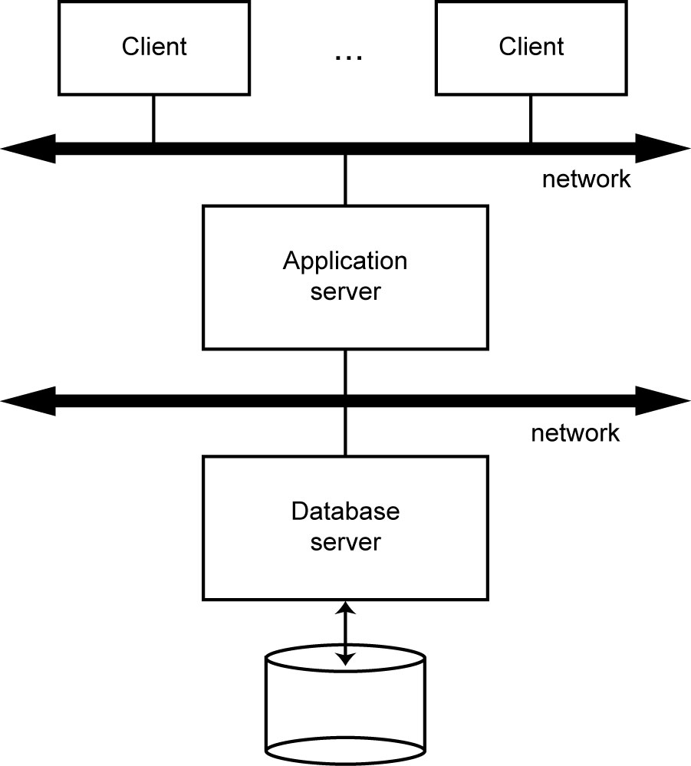
Database Server

Slide 17
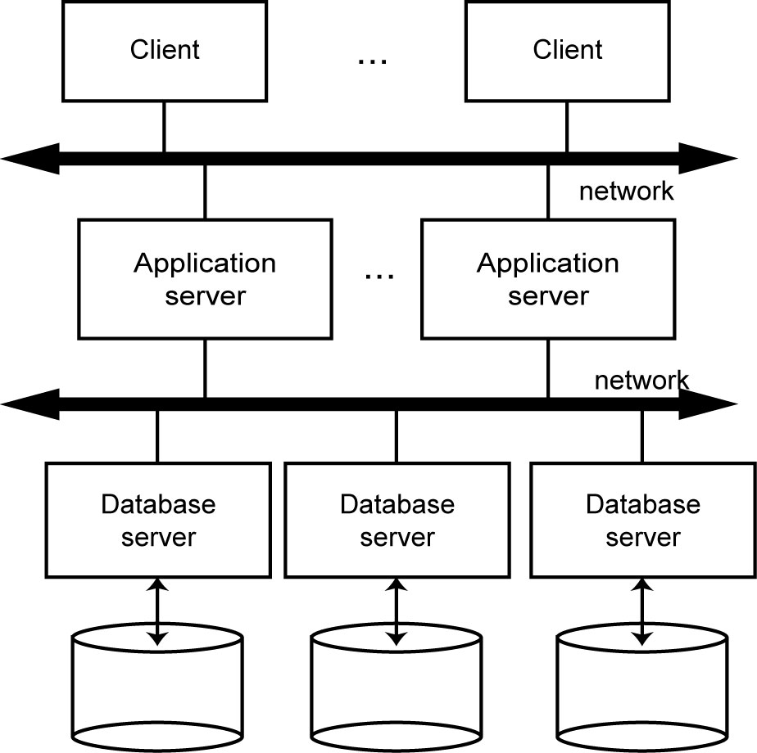
Distributed Database Servers

Slide 18
Homogeneous vs. Heterogeneous
Homogeneous DDBS
The same database management system runs on all computers.
All sites have identical software
Are aware of each other and agree to cooperate in processing user requests.
Each site surrenders part of its autonomy in terms of right to change schemas or software
Appears to user as a single system
Example: All Oracle or all DB2
Heterogeneous DDBS
Different DBMS’s run on different computers.
Different sites may use different schemas and software
Difference in schema is a major problem for query processing
Difference in software is a major problem for transaction processing
Legacy systems
Company merger

Slide 19
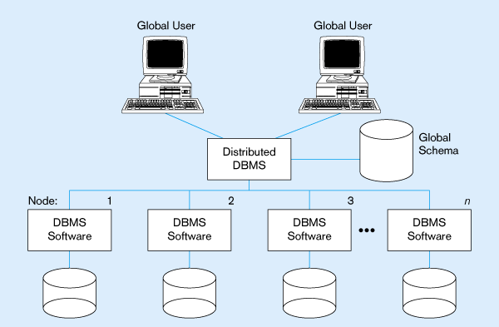
Homogeneous Database
Identical DBMSs

Slide 20
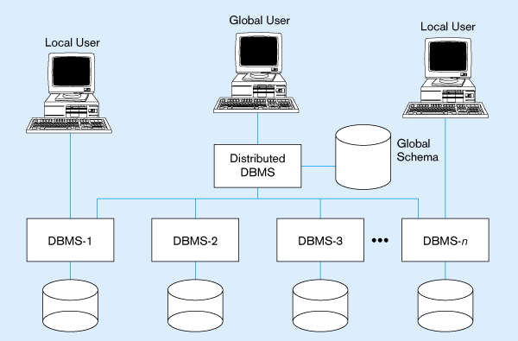
Typical Heterogeneous Environment
Non-identical DBMSs

Slide 21
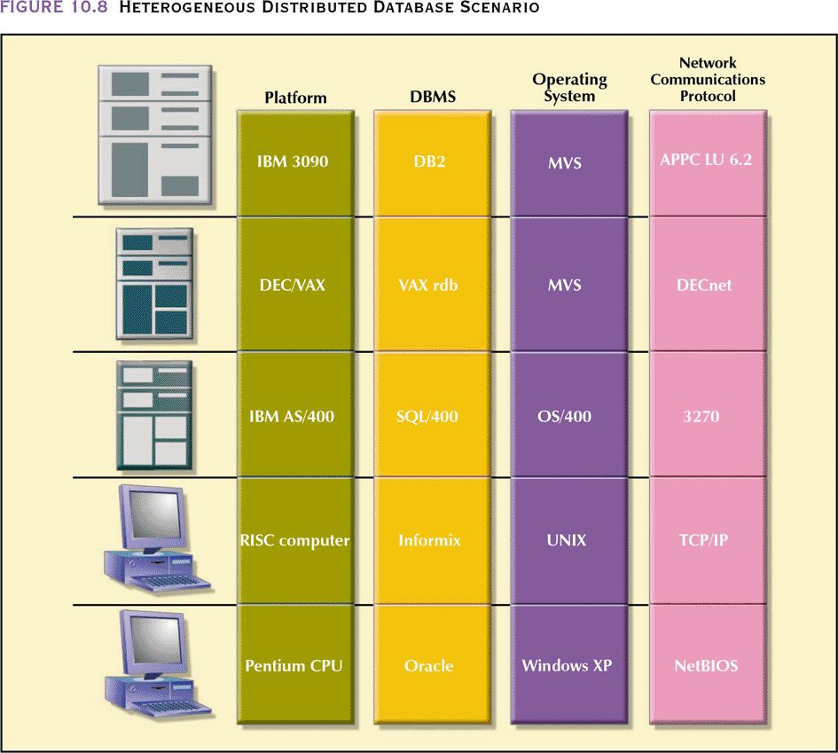
Heterogeneous Distributed Database Scenario

Slide 22
Fragmentation

Slide 23
Global Relations, Fragments and Physical Images
R
Separating concepts of fragmentation and allocation
Explicit control of redundancy
Independence from local databases
Allows for:
Fragmentation Transparency
Location Transparency
Local Mapping Transparency
R₁
R¹₁
R¹
(Site 1)
R¹₂
R₂
R²₁
R²
(Site2)
R₃
R²₂
R³₂
Global
Relation
Fragments
R³
(Site3)
R³₃
Physical Images

Slide 24
Rules for Data Fragmentation
Three Correctness of fragmentation rules:
1. Completeness: If relation R decomposed into fragments R1, R2, ... Rn, each data item that can be found in R must appear in at least one fragment.
2. Reconstruction: Must be possible to define a relational operation that will reconstruct R from the fragments.
- for horizontal fragmentation: Union operation
- for vertical: Join
3. Disjointness: If data item di appears in fragment Ri, then should not appear in any other fragment.
- Exception: vertical fragmentation.
- For horizontal fragmentation, data item is a tuple.
- For vertical fragmentation, data item is an attribute.

Slide 25
Types of Data Fragmentation
Vertical Fragmentation
Projection on relation (subset of attributes)
Reconstruction by join
Updates require no tuple migration
Horizontal Fragmentation
Selection on relation (subset of tuples)
Reconstruction by union
Updates may requires tuple migration
Mixed Fragmentation
A fragment is a Select-Project query on relation.
Vertical Fragmentation
Horizontal Fragmentation

Slide 26
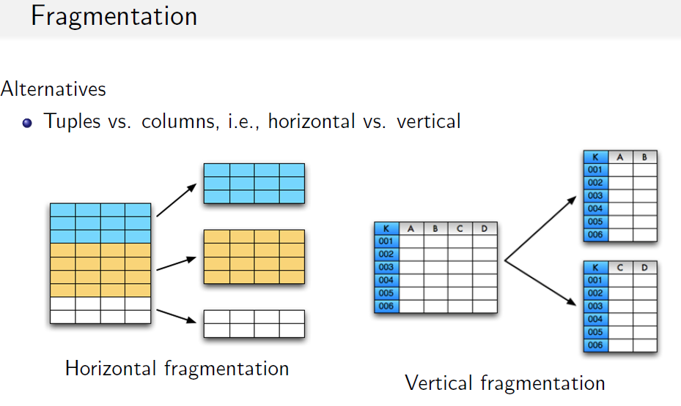

Slide 27
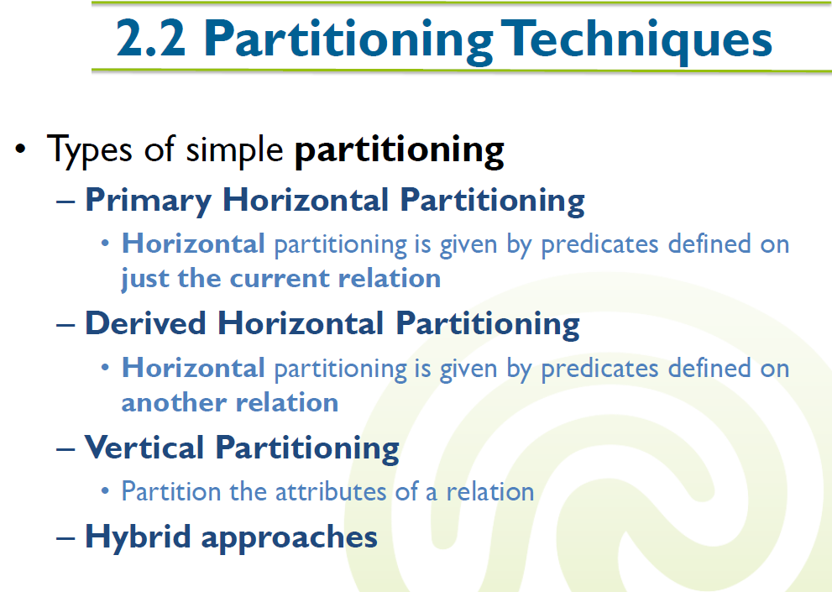

Slide 28
Horizontal fragmentation
Student(reg_no, name, gender, address, campus)
STUDENT
REG_NO | NAME | GENDER | ADDRESS | CAMPUS
123 | Raghu | M | Bengaluru | Chennai
134 | Mark | M | Pune | Mumbai
108 | Geetha | F | Chennai | Mumbai
119 | Taj | F | Hyderabad | Hyderabad
231 | Steve | M | Mumbai | Delhi
145 | Gautam | M | Ooty | Chennai
205 | Pooja | F | Kanpur | Delhi
176 | Justin | M | Simla | Mumbai
345 | Rahim | M | Kolkata | Hyderabad
765 | Sreejit | M | Ahmedabad | Chennai

Slide 29
Horizontal Fragmentation - Example
Schema
STUDENT(Reg_No, Name, Gender, Address, Campus)
SELECT * FROM Student WHERE campus = ‘Chennai’;
STUDENT
REG_NO | NAME | GENDER | ADDRESS | CAMPUS
123 | Raghu | M | Bengaluru | Chennai
145 | Gautam | M | Ooty | Chennai
765 | Sreejit | M | Ahmedabad | Chennai

Slide 30
Horizontal Fragmentation - Example
Schema
STUDENT(Reg_No, Name, Gender, Address, Campus)
SELECT * FROM Student WHERE campus = ‘Mumbai’;
STUDENT
REG_NO | NAME | GENDER | ADDRESS | CAMPUS
134 | Mark | M | Pune | Mumbai
108 | Geetha | F | Chennai | Mumbai
176 | Justin | M | Simla | Mumbai

Slide 31
Horizontal Fragmentation - Example
Schema
STUDENT(Reg_No, Name, Gender, Address, Campus)
SELECT * FROM Student WHERE campus = ‘Delhi’;
STUDENT
REG_NO | NAME | GENDER | ADDRESS | CAMPUS
231 | Steve | M | Mumbai | Delhi
205 | Pooja | F | Kanpur | Delhi

Slide 32
Horizontal Fragmentation - Example
Schema
STUDENT(Reg_No, Name, Gender, Address, Campus)
SELECT * FROM Student WHERE campus = ‘Hyderabad’;
STUDENT
REG_NO | NAME | GENDER | ADDRESS | CAMPUS
119 | Taj | F | Hyderabad | Hyderabad
345 | Rahim | M | Kolkata | Hyderabad

Slide 33
Horizontal Fragmentation
There are two types of horizontal fragmentation
Primary horizontal fragmentation
Derived horizontal fragmentation

Slide 34
Primary Horizontal Fragmentation
What is it?
It is about fragmenting single table horizontally with set of simple conditions.
What do we require?
The procedure to find the simple conditions that are required to fragment the table.
How to find the simple conditions?
Simple predicates
Min-term predicates

Slide 35
Simple predicates
Given a relation R with set of n attributes, a simple predicate p is a condition of the form as follows;
attribute_{i} comparison-operator value
Here,
Attribute is any attribute of the relation R
Comparison operator can be one of =,<, ≤, >, ≥, ≠
Value is the permitted value for the domain of that attribute
Example:
REG_NO = 119
GENDER = ‘M’
GRADE > 5

Slide 36
Simple predicates
Set of simple predicates
A relation usually fragmented using multiple simple predicates collectively.
Example:
Employee(Emp_id, Ename, Department, Office)
P = {office = ‘Chennai’, department = ‘Design’}

Slide 37
Desirable properties of simple predicates
The set of simple predicates should be complete and minimal.
Complete
not missing any data and equal probability of access by every application.
Minimal
If all the predicates of a set P are relevant, then P is minimal. That is, there should be at least one application that accesses fragments f1 and f2 differently.

Slide 38
Min-term predicates
Can we use simple predicates for fragmentation directly?
NO
What is min-term predicate?
It is a conjunction of different simple predicates either in its regular form or in negated form to define a fragment.
Formal definition (from Principles of Distributed Database Systems by M. Tamer Özsu)
Given R and Pr = {p₁, p₂, …,p_{m}} define M = {m₁,m₂,…,m_{r}} as
M = { m_{i} | m_{i} = ∧_{pj∈Pr} p_{j}* }, 1≤j≤m, 1≤i≤z
where p_{j}* = p_{j} or p_{j}* = ¬(p_{j}).

Slide 39
Min-term predicates
m1: office = ‘Chennai’ ∧ department = ‘Design’
m2 : office = ‘Chennai’ ∧ ¬ (department = ‘Design’)
m3 : ¬ (office = ‘Chennai’) ∧ department = ‘Design’
m4 : ¬ (office = ‘Chennai’) ∧ ¬ (department = ‘Design’)
Are these min-term fragments ends up in a valid fragmentation?

Slide 40
Primary horizontal fragmentation
A horizontal fragment R_{i} of relation R consists of all the tuples of R which satisfy a minterm predicate m_{i}.
Given a set of minterm predicates M, there are as many horizontal fragments of relation R as there are minterm predicates.

Slide 41
Primary horizontal fragmentation - Example
Fragment F1 derived using min-term predicate m1
(office = ‘Chennai’) ∧ (department = ‘Design’)
EMP_ID | ENAME | DEPARTMENT | OFFICE
E1 | Kesav | Design | Chennai
E4 | Ragul | Design | Chennai
The SQL query to fragment using min-term predicate m1
SELECT * FROM Employee WHERE office = ‘Chennai’ AND department = ‘Design’;

Slide 42
Primary horizontal fragmentation - Example
Fragment F2 derived using min-term predicate m2
(office = ‘Chennai’) ∧ ¬ (department = ‘Design’)
EMP_ID | ENAME | DEPARTMENT | OFFICE
E3 | Jeevan | Finance | Chennai
E5 | John | Production | Chennai
The SQL query to fragment using min-term predicate m2
SELECT * FROM Employee WHERE office = ‘Chennai’ AND department <> ‘Design’;

Slide 43
Primary horizontal fragmentation - Example
Fragment F3 derived using min-term predicate m3
¬ (office = ‘Chennai’) ∧ (department = ‘Design’)
EMP_ID | ENAME | DEPARTMENT | OFFICE
E10 | Stella | Design | Mumbai
E9 | Sanjeev | Design | Delhi
The SQL query to fragment using min-term predicate m3
SELECT * FROM Employee WHERE office <> ‘Chennai’ AND department = ‘Design’;

Slide 44
Primary horizontal fragmentation - Example
Fragment F4 derived using min-term predicate m4
¬ (office = ‘Chennai’) ∧ ¬ (department = ‘Design’)
EMP_ID | ENAME | DEPARTMENT | OFFICE
E11 | Kesav | Finance | Mumbai
E7 | Steve | Production | Delhi
The SQL query to fragment using min-term predicate m4
SELECT * FROM Employee WHERE office <> ‘Chennai’ AND department <> ‘Design’;

Slide 45
Derived horizontal fragmentation

Slide 46
Derived horizontal fragmentation
The process of creating horizontal fragments of a table in question based on the already created horizontal fragments of another relation (for example, base table) is called Derived Horizontal Fragmentation
Student
Owner(L)
Link L
Grade_Detail
Member(L)

Slide 47
Semi-join
Semi-join is a join operation that results in a structure and records of one table that match with the records of other table.
R(a1, a2, a3) S(b1, b2, a1)
S ⋉ R = S(b1, b2, a1)
Records of S will be those that have same a1 values in both R and S.

Slide 48
Example
STUDENT
REG_NO | NAME | GENDER | ADDRESS | CAMPUS
123 | Raghu | M | Bengaluru | Chennai
134 | Mark | M | Pune | Mumbai
108 | Geetha | F | Chennai | Mumbai
119 | Taj | F | Hyderabad | Hyderabad
231 | Steve | M | Mumbai | Delhi
GRADE_DETAIL
REG_NO | SUBJECT | GRADE
123 | DBMS | A
108 | DS | B
108 | NLP | A
119 | DBMS | S
231 | DBMS | B
123 | CG | S
134 | NLP | A

Slide 49
Example
Let us assume that the owner relation STUDENT is horizotanlly fragmented as follows;
STUDENT₁ = σ_{CAMPUS≤‘Chennai‘} (STUDENT)
STUDENT₂ = σ_{CAMPUS>‘Mumbai‘} (STUDENT)
STUDENT₃ = σ_{CAMPUS>‘Hyderabad‘} (STUDENT)
STUDENT₄ = σ_{CAMPUS>‘Delhi‘} (STUDENT)

Slide 50
Example
The member relation Grade_Detail should also be fragmented into 4 fragments using the fragments of owner relation Student.
GD₁ = GRADE_DETAIL ⋉ STUDENT₁
GD₂ = GRADE_DETAIL ⋉ STUDENT₂
GD₃ = GRADE_DETAIL ⋉ STUDENT₃
GD₄ = GRADE_DETAIL ⋉ STUDENT₄

Slide 51
Example
GRADE_DETAIL ⋉ STUDENT₁
GRADE_DETAIL ⋉ STUDENT₂
GD₁
REG_NO | SUBJECT | GRADE
123 | DBMS | A
123 | CG | S
GD₂
REG_NO | SUBJECT | GRADE
108 | DS | B
108 | NLP | A
134 | NLP | A
GRADE_DETAIL ⋉ STUDENT₃
GRADE_DETAIL ⋉ STUDENT₄
GD₃
REG_NO | SUBJECT | GRADE
119 | DBMS | S
GD₄
REG_NO | SUBJECT | GRADE
231 | DBMS | B

Slide 52
Vertical Fragmentation
The schema of original relation R is split vertically (with respect to attributes) into several smaller schemas.
All schemas must contain a common candidate key to ensure lossless join property.
CUSTOMER(Cust_ID, Name, Gender, Address, DOB, Contact)
CUSTOMER1(Cust_ID, Name, Contact)
CUSTOMER(Cust_ID, Gender, Address, DOB)

